Slide 1

EVALUATION OF THE IMPACT OF ALCOHOL CONTROL POLICIES ON MORBIDITY AND MORTALITY IN LITHUANIA AND OTHER BALTIC STATES
The Baltic Alcohol Control Policy Impact Study Collaborators

Slide 2
TAXATION AND ECONOMIC CHANGES PREDICT RECORDED ALCOHOL CONSUMPTION: A CASE STUDY IN LITHUANIA
2
Alexander Tran, PhD

Slide 3
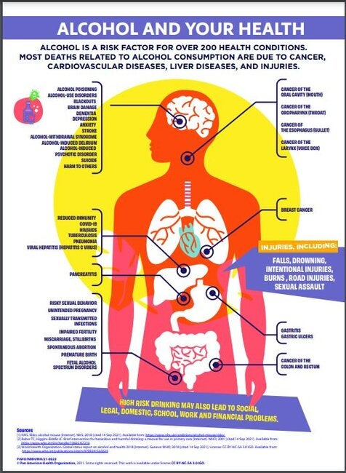
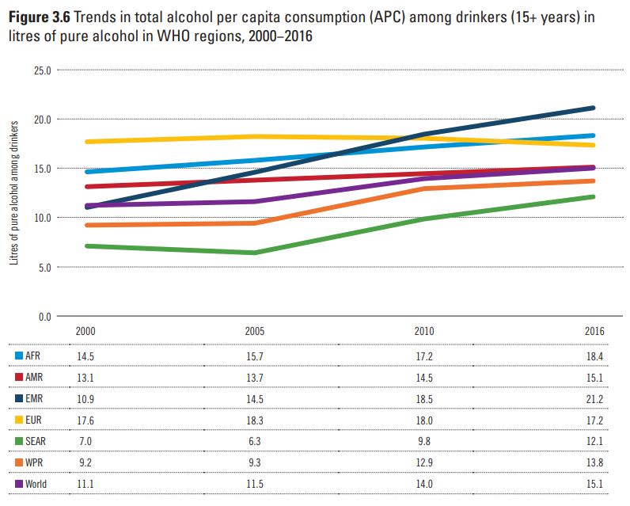
Alcohol and public health
Alcohol consumption is related to increased risk of cardiovascular disease, liver disease, and cancer (Rehm et al., 2017)
Alcohol consumption poses a significant public health risk, consumption is among the highest in the European region. (World Health Organization, 2018; Vos et al., 2020)
Consumption is projected to rise globally by 2030, while rates of abstention are dropping (Manthey et al., 2019)

Slide 4
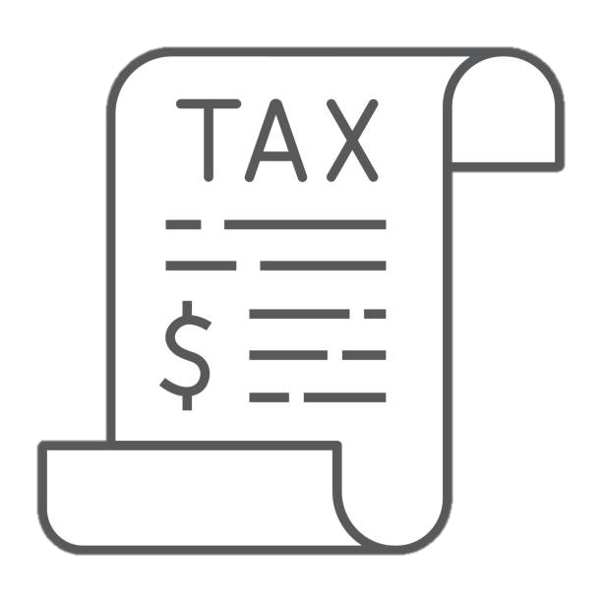


Policy changes and alcohol-related harm
Alcohol consumption and harm can be reduced through public policy (Babor et al., 2010; Stockwell et al., 2020; Neufeld & Rehm, 2018)
E.g., alcohol control policies have been shown to reduce traffic-related injuries (Rehm et al., 2020)
Meanwhile repealing of alcohol control polices is associated with increased alcohol related harms (Andreasson et al., 2006; Room et al., 2013)

Slide 5

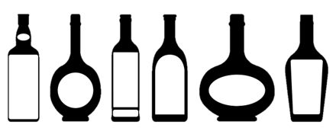

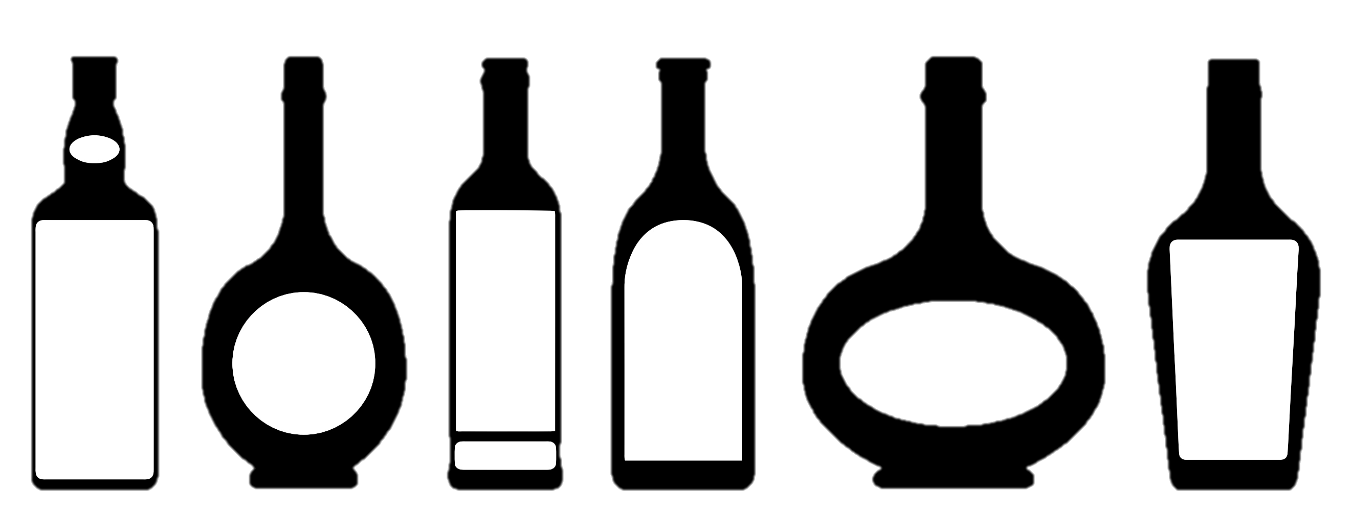
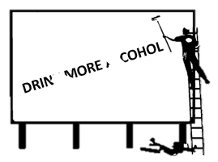
WHO best buy’s
The World Health Organization (WHO) has identified 3 categories of public policy that are effective and cost-effective in reducing alcohol-attributable harm (Chisholm et al., 2018);
Taxation
Decreased availability
Bans on marketing and advertising

Slide 6

Taxation and alcohol
$$$
$$
A review and meta-analysis of studies showed a medium effect size of taxation on alcohol-related disease, r = .347. (Wagenaar et al., 2010)
Price changes may not affect all beverages equally e.g., alcohol beverage types can be substituted or pass-through rates may differ (Elder et al., 2010; Nelson & Moran, 2019)
$
$

Slide 7
Lithuania
Year of Sobriety (several alcohol control policies introduced including heavy increase in taxation)
Lithuania is among the highest globally for alcohol per capita consumption (APC) according to WHO (WHO, 2018)
All 3 best buy policies have since implemented and the ‘Year of Sobriety’ was announced in 2008
Taxes were increased multiple times between 2008 and 2019
Two periods of increased taxation (in 2008 and 2017) were expected to have marked reductions in affordability (Rehm et al., 2021)
2000
2001
2002
2003
2004
2005
2006
2007
2008
2009
2010
2011
2012
2013
2014
2015
2016
2017
2018
Lithuania joins the European Union
Dramatic increase in alcohol taxation

Slide 8
Present study
We investigated the effect of two alcohol taxation policies on total recorded alcohol consumption in Lithuania
We conducted a regression analysis on data between 2001 and 2019 for alcohol sales (all alcohol types; specific beverage types) for 15+ years of age
Controlling for gross domestic product, consumer price index, time trends

Slide 9
Methods
Dataset: Official yearly alcohol sales data from 2001 to 2019 (n = 18) obtained from Statistics Lithuania
Predictor: Alcohol taxation (in 2008 and 2017) were dummy-coded
Covariates: Yearly GDP, CPI, time trends
Outcome variables: per capita sales of total alcohol, spirits, wine and fermented beverages, and beer

Slide 10
Results
Models indicate a significant effect of time on alcohol consumption (quadratic trend)
Consumption reached a peak in between 2006 and 2012 and has steadily been declining
Both policies had an effect on per capita alcohol consumption (all alcohol types)
Policy in 2017 had significant effects on spirits and wine and fermented beverages, Policy in 2008 had only a marginal effects
No policy effects on beer

Slide 11
Results: Total per capita consumption
 | Effect | SE | t-value | p-value | Adjusted-R²
Model 1 |  |  |  |  | 0.88
Intercept | 8.04 | 1.44 | 5.78 | p = .001
Linear Time | 0.063 | 0.011 | 5.42 | p = .001
Quadratic Time | -0.00030 | 0.000031 | -9.88 | p = .001
GDP | 0.14 | 0.10 | 1.33 | p = 0.20
CPI (Inflation) | -0.054 | 0.030 | -1.80 | p = .093
Model 2 |  |  |  |  | 0.95
Intercept | 5.30 | 1.15 | 4.60 | p = .001
Linear Time | 0.016 | 0.014 | 1.14 | p = 0.27
Quadratic Time | -0.00017 | 0.000034 | -5.08 | p = .001
GDP | 0.39 | 0.091 | 4.22 | p = 0.0012
CPI (Inflation) | -0.10 | 0.023 | -4.50 | p = .001
Policy 2008 | 1.06 | 0.40 | 2.60 | p = 0.023
Policy 2017 | -1.64 | 0.36 | -4.54 | p = .001
Note: Model 1 (no policy effects) and Model 2 (Policy 2008 and Policy 2017) for total recorded alcohol consumption per capita (individuals 15+ years of age), GDP = gross domestic product, CPI = consumer price index

Slide 12
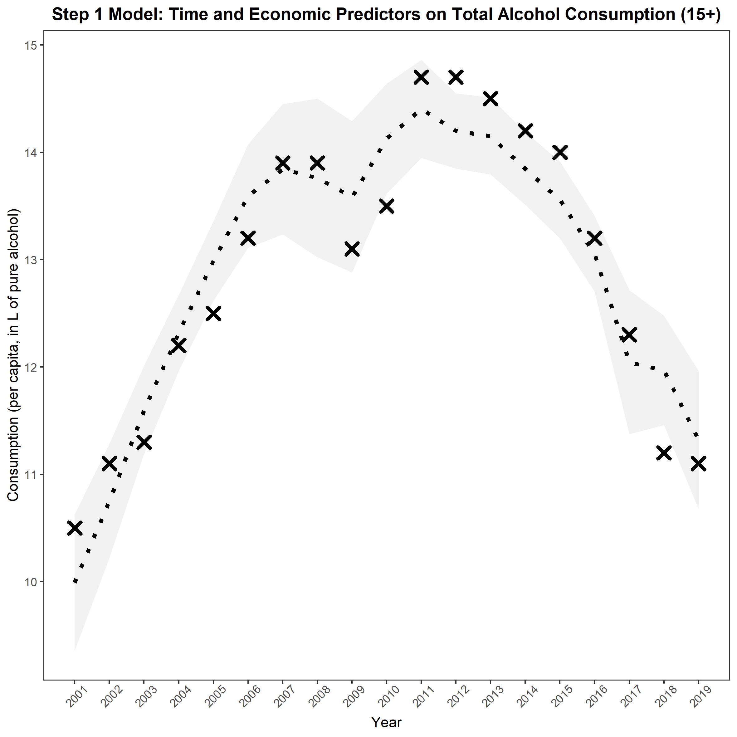

Slide 13
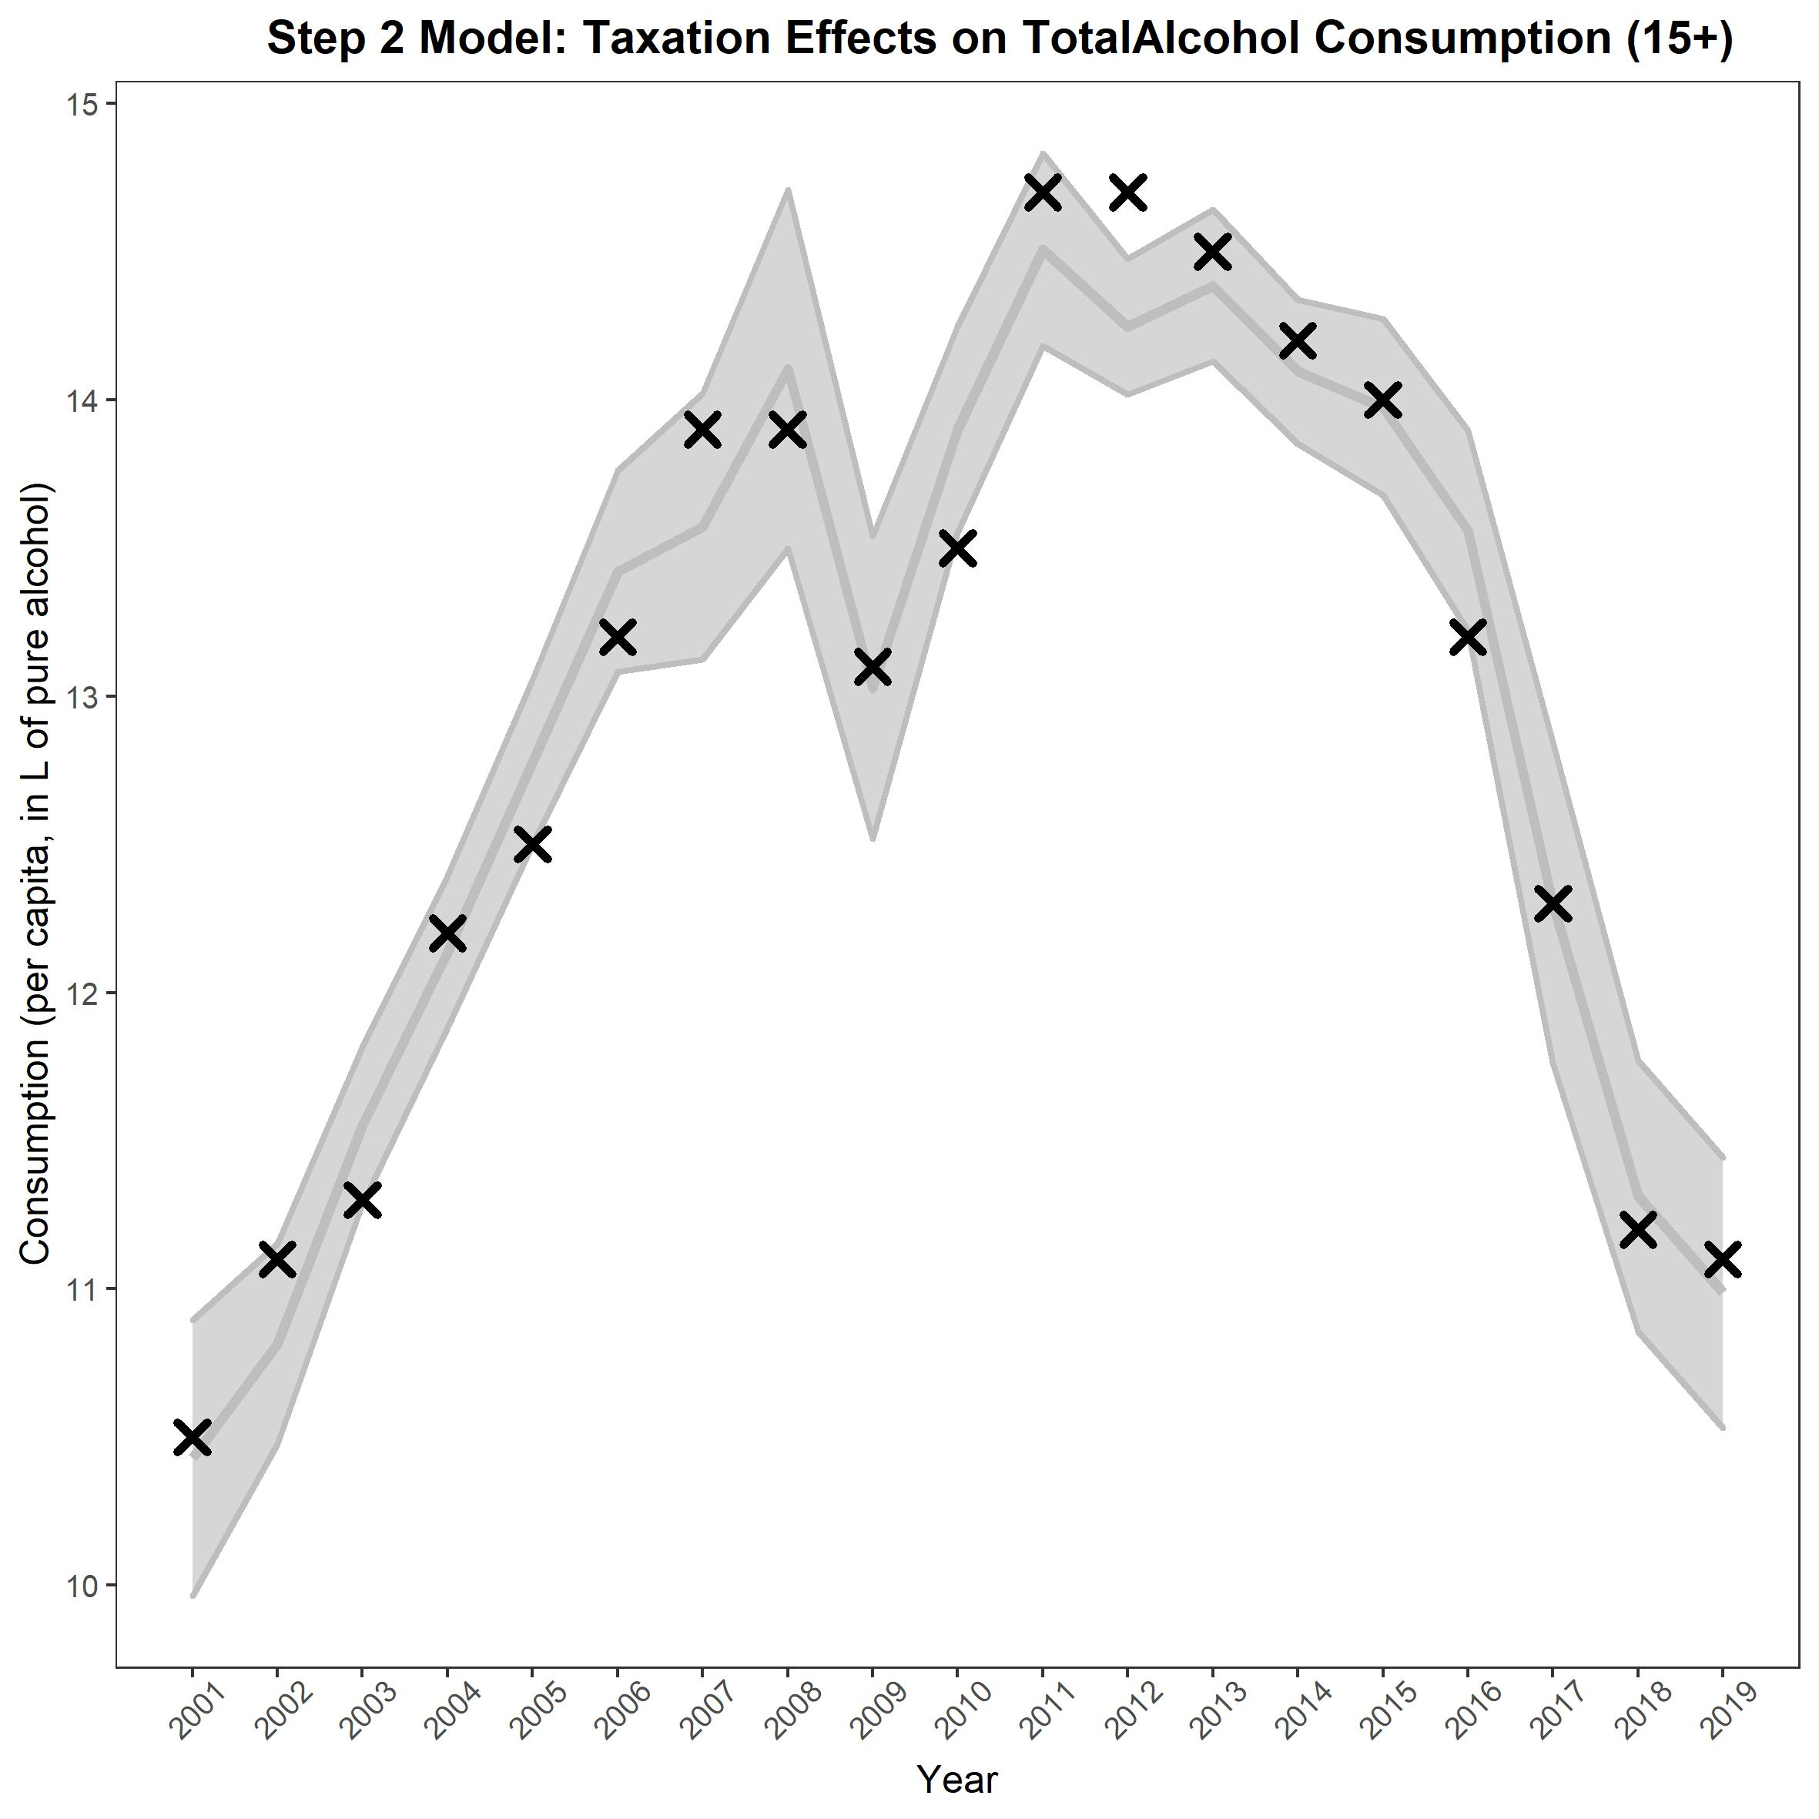

Slide 14
Results: Beverage specific consumption
 | Effect | SE | t-value | p-value | Adjusted-R²
Spirit consumption |  |  |  |  | 0.91
Intercept | -1.17 | .89 | -1.32 | p = .21
Linear Time | -0.013 | 0.010 | -1.20 | p = 0.25
Quadratic Time | -0.00026 | 0.000026 | -0.98 | p = .34
GDP | 0.36 | 0.070 | 5.09 | p = .001
CPI (Inflation) | -0.040 | 0.018 | -2.30 | P =.040
Policy 2008 | .56 | 0.31 | 1.80 | p = 0.097
Policy 2017 | -0.77 | 0.28 | -2.80 | p = .016
Beer consumption |  |  |  |  | 0.86
Intercept | 3.87 | 0.68 | 5.70 | p = .001
Linear Time | 0.022 | 0.0082 | 2.63 | p = 0.022
Quadratic Time | -0.000088 | 0.000020 | -4.35 | p = .001
GDP | 0.019 | 0.053 | 0.35 | p = 0.73
CPI (Inflation) | -0.047 | 0.013 | -3.50 | p = .0043
Policy 2008 | -0.039 | 0.23 | -0.16 | p = .87
Policy 2017 | -0.34 | 0.21 | -1.60 | p = .13
Wine and fermented beverage consumption |  |  |  |  | 0.89
Intercept | -0.091 | 0.82 | -0.11 | p = .91
Linear Time | 0.013 | 0.010 | 1.31 | p = .21
Quadratic Time | -0.000091 | 0.000024 | -3.71 | p = .0029
GDP | 0.11 | 0.065 | 1.75 | p = .10
CPI (Inflation) | -0.042 | 0.016 | -2.55 | p = .025
Policy 2008 | 0.55 | 0.29 | 1.92 | p = .079
Policy 2017 | -0.58 | 0.26 | -2.27 | p =.042

Slide 15
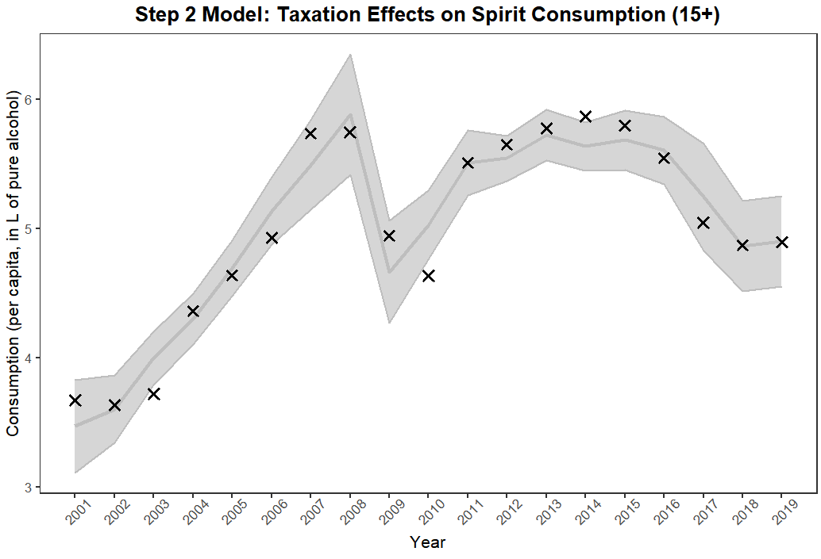
Spirit consumption

Slide 16
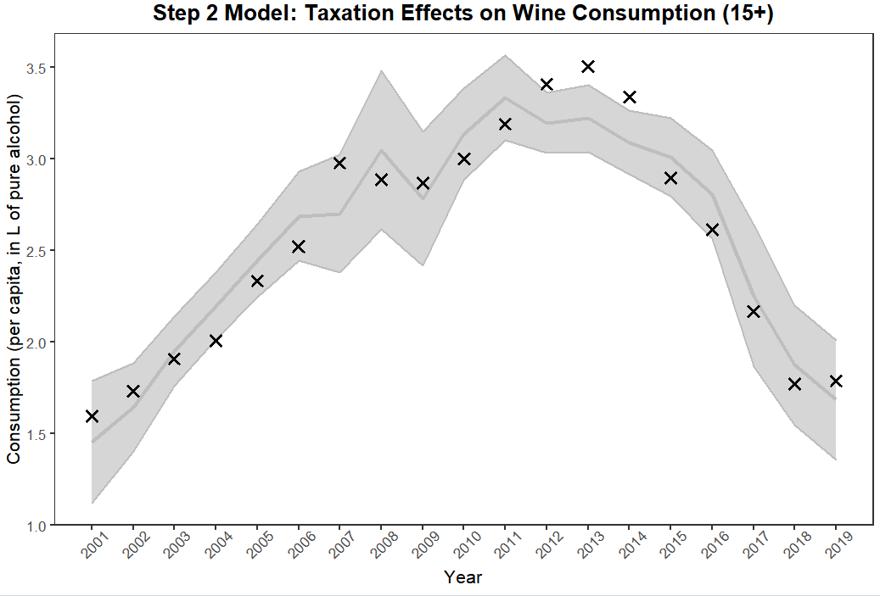
Wine and fermented beverage consumption

Slide 17
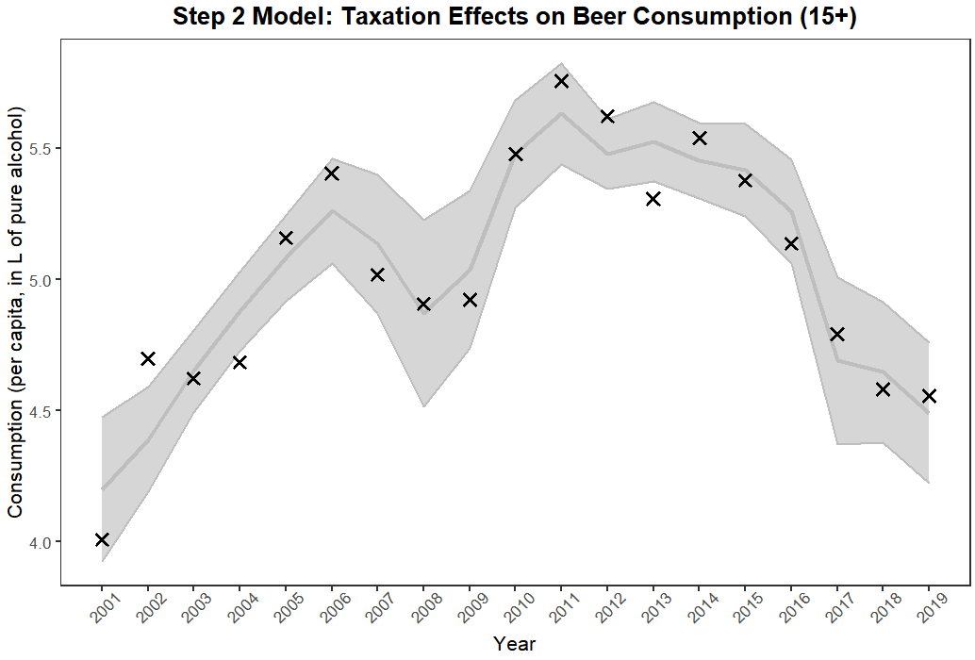
Beer consumption

Slide 18
Conclusions
Lithuanian alcohol consumption has begun to decline in recent years
Total recorded alcohol consumption responds to changes in taxation (specifically taxes that reduce affordability, Rehm et al., 2021)
More affordable alcohol (i.e., beer) were not as responsive to pricing changes, more research on alcohol substitution is warranted

Slide 19
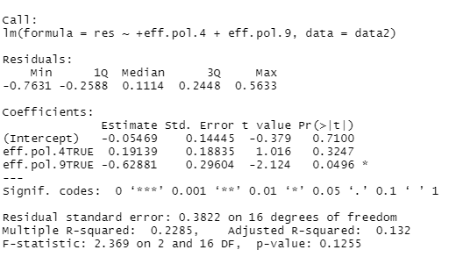
Extra Slide: Effect of policies on residuals of Model 1

